Slide 1

TEAM 15
Price Purvis, Drew Buley, Jaiden Beck, Wil Davis, Chad Stark

Slide 2


ECE 4950 Project Overview
Group Number: Team 15
Members: Price Purvis, Drew Buley, Jaiden Beck, Wil Davis, Chad Stark
Objectives Completed:
Took time to understand the Arduino by digging into its datasheets
Got hands-on with wiring spliced connections and measured voltages to troubleshoot issues
Used Simulink to bring the Arduino to life and get the project working
Learned Simulink from the ground up to control hardware and visualize graphs
Picked up some Arduino skills
Explored 3D modeling
Clemson University | Electrical & Computer Engineering

Slide 3
Team Member Contributions
Arduino Support:
Drew Buley, Price Purvis, Will Davis
Simulink Support:
Drew Buley, Price Purvis, Wil Davis
Troubleshooting Support:
Everyone
3D Modeling:
Price Purvis
Presentation:
Chad Stark
Research Paper:
Wil Davis
Clemson University | Electrical & Computer Engineering

Slide 4
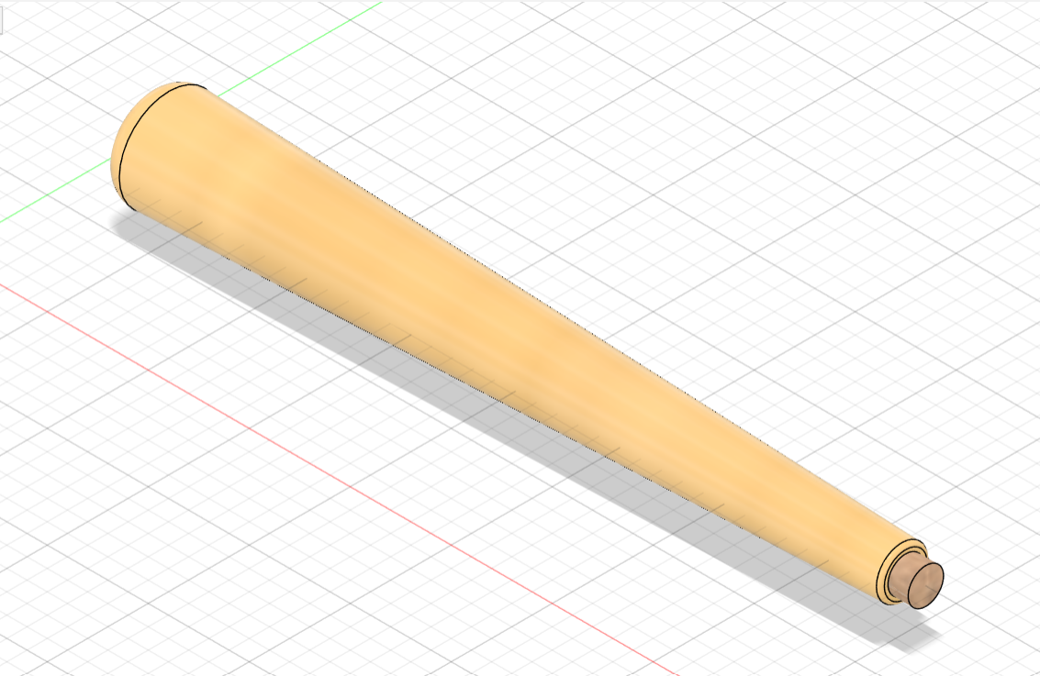
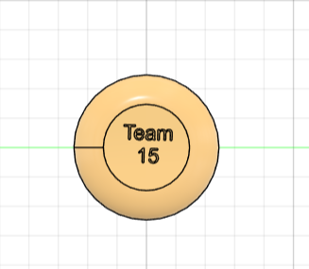
3D Design
Clemson University | Electrical & Computer Engineering

